Slide 1
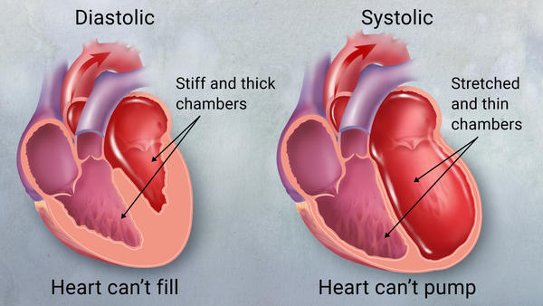
Cardiac glycosides
Pharmacognosy
3rd Class, 1st Semester / 2023
By:
Ph Faten Essam
MSc pharmacy science

Slide 2
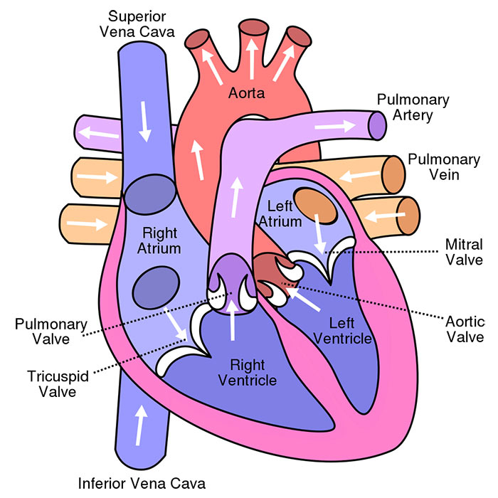
Cardiac glycoside
Are important class of naturally occurring secondary compounds that widely distributed in nature with potential cardiovascular action.
Which have the ability to exert specific powerful action on the cardiac muscle

Slide 3
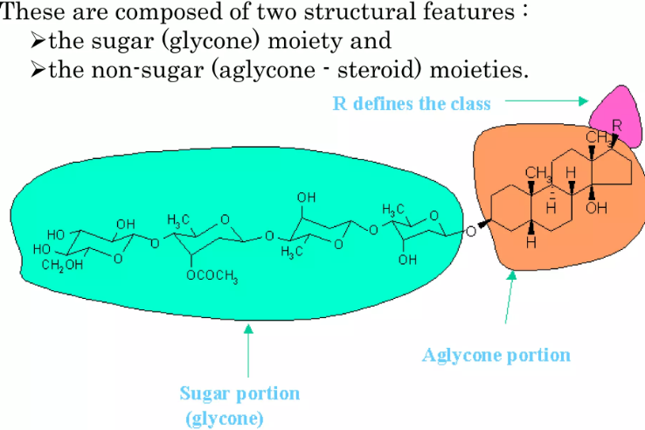
Structure

Slide 4
General properties of cardiac glycosides
Amorphous powder
Bitter taste
Soluble in water
Very toxic compound
Odorless

Slide 5
Uses
To treat congestive heart failure
To treat atrial fibrillation and flutter

Slide 6
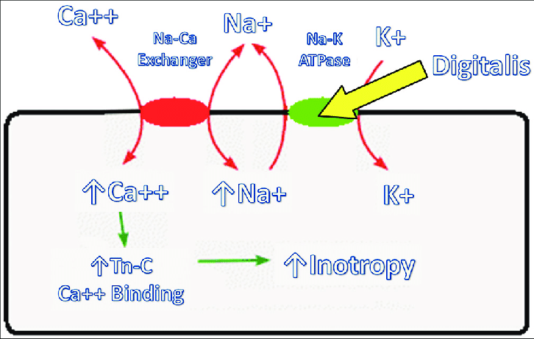
Mechanism of action

Slide 7
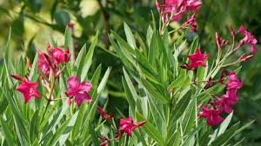
Nerium oleander
Oleander is one of the most poisonous plants in the world and contains numerous toxic compounds, many of which can cause death to people, especially young children
The most significant of these toxins are oleandrin and nerine, which are cardiac glycosides.

Slide 8
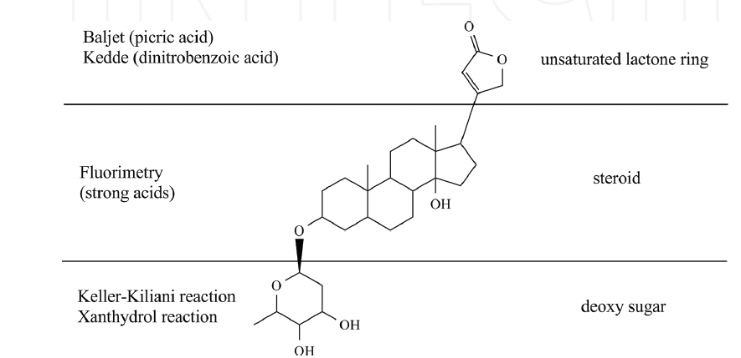
Procedure

Slide 9
Baljet test
To the 2-3 ml of chloroform extract, add few drops of Baljet's reagent → orange or red will be found
Eq ?????

Slide 10
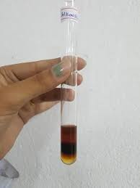
Liebermann test :
Take 2 ml of chloroform extract, and add 5 drop carefully of conc. H₂SO₄ drop by drop on the side of the test tube violet color at
first will be developed to green when standing .
Mechanism of action H.W

Slide 11
Keller killiani's test
Add 2ml of glacial acetic acid to 2ml chloroform extract in a test tube and a drop of ferric chloride solution. Then add 1 ml carefully of conc H₂SO₄ drop by drop on the side of the test tube → a reddish brown ring will be formed

Slide 12
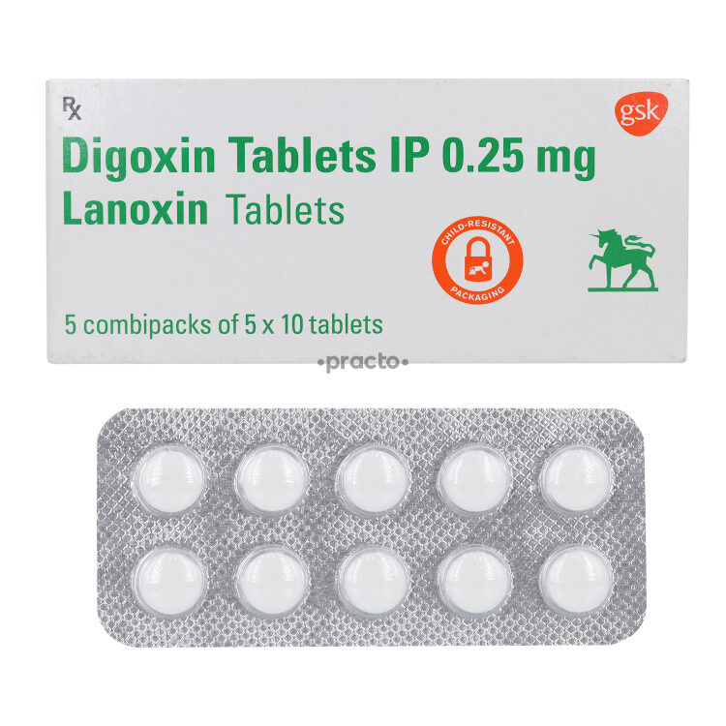
Drug used in this lab.
DIGOXIN is indicated for the treatment of mild to moderate heart failure in adults

Slide 13
This lab may include report sheet so be careful !!!!

